Slide 1
Laser Cooling by Sawtooth Wave Adiabatic Passage
Huan Bui
ZGS – August 26th, 2022

Slide 2
Laser Cooling

Slide 3
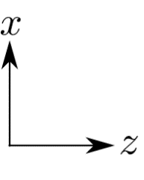
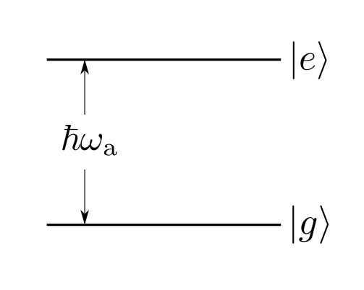
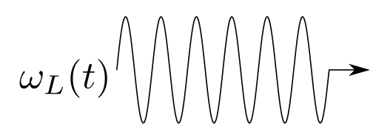
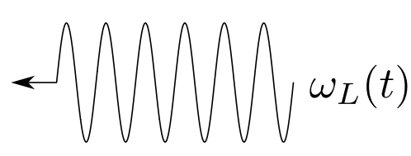
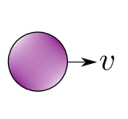
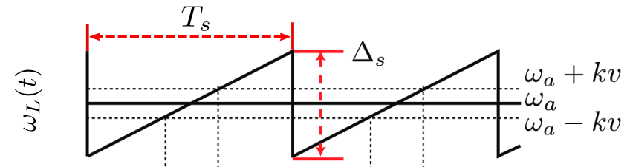
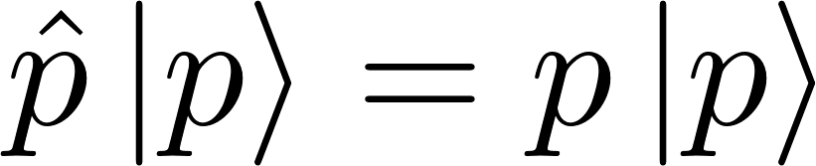
Basic mechanism

Slide 4
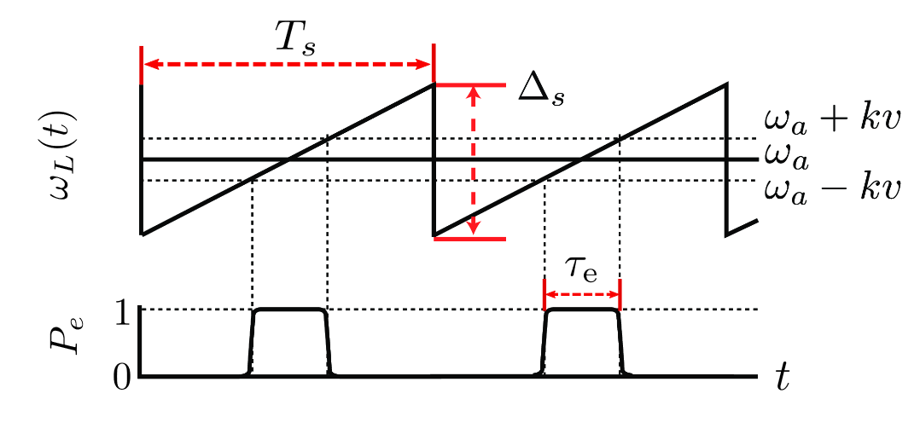

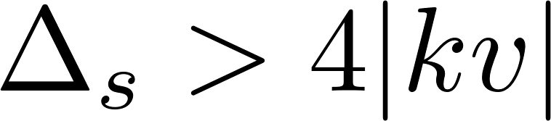
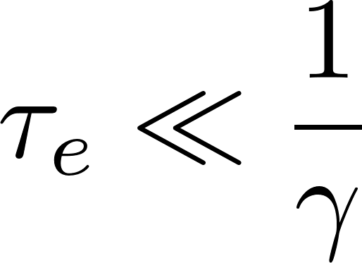

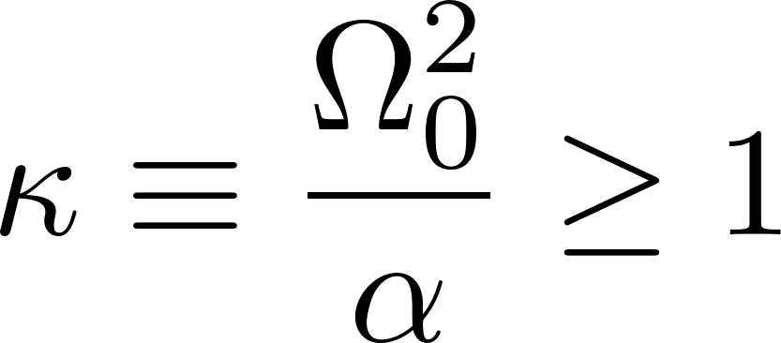

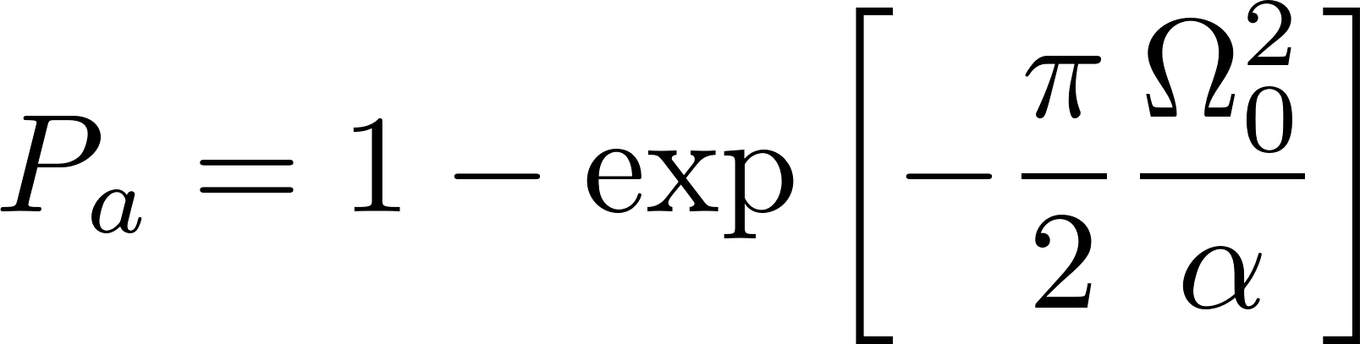
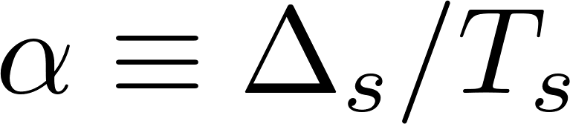
Requirements
Must begin sweep in :
Low decay probability during :
Large adiabatic transition probability:
: adiabaticity parameter

Slide 5

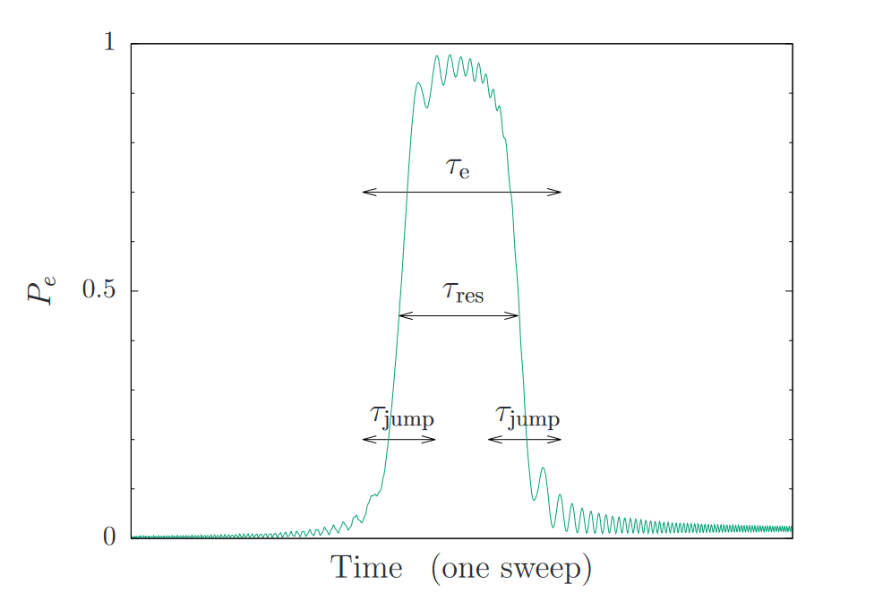
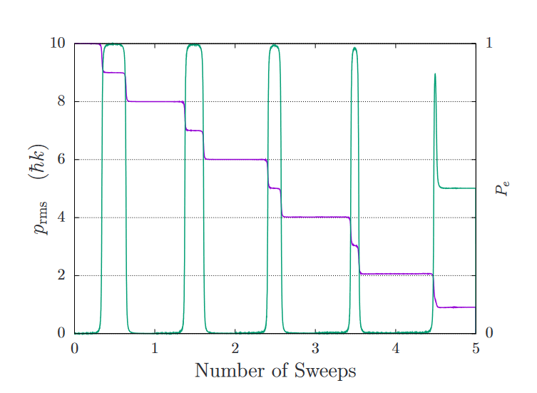
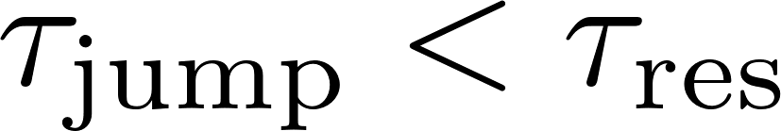
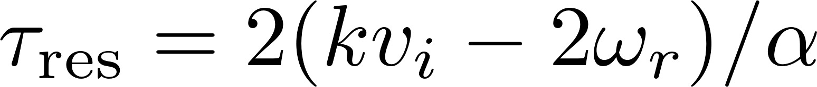

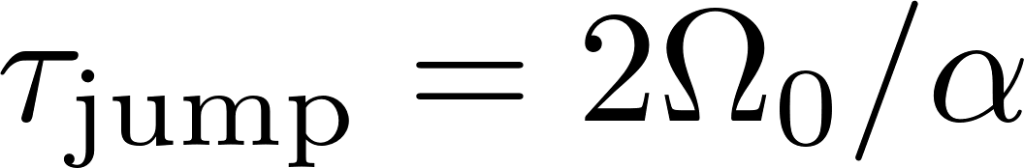
Validity
Particle interacts sequentially with one wave and then the other
→ Need sufficiently large
When adiabatic:
Want

Slide 6
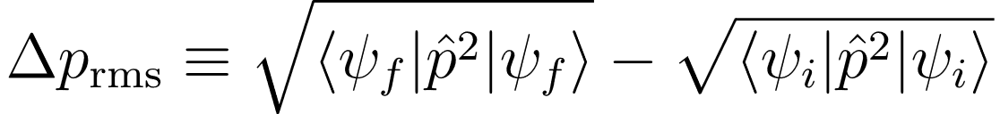
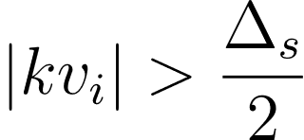
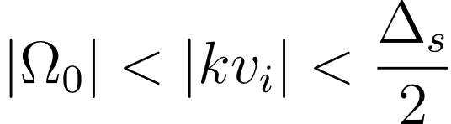

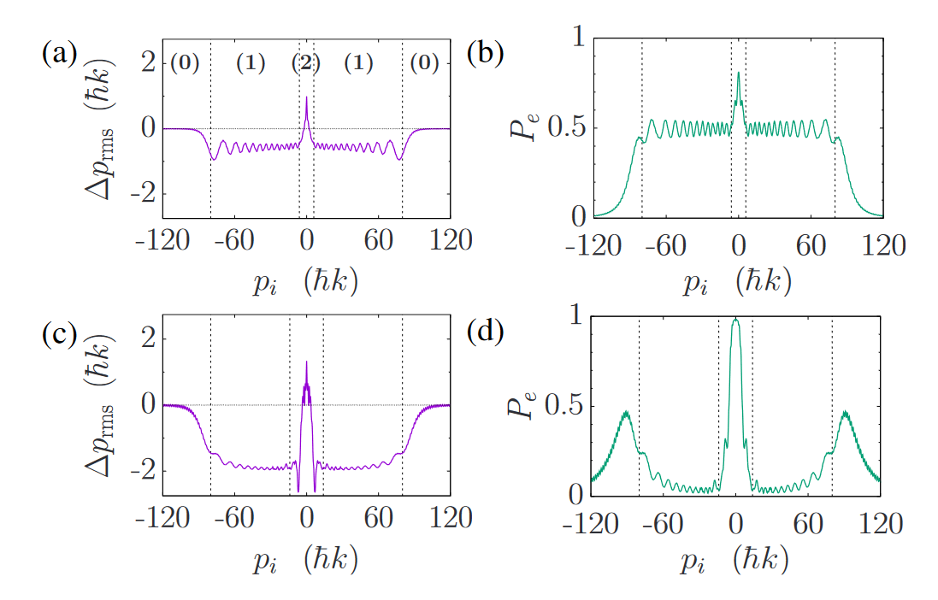
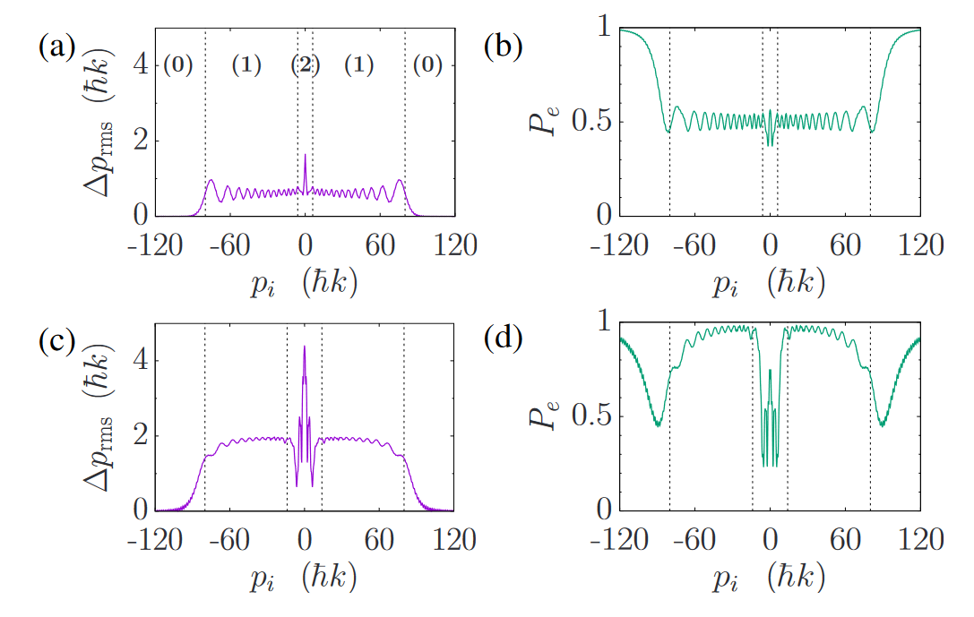
Forces and capture range
Conservative forces:
3 velocity regimes:
(0)
(1)
(2)
no interaction
high-v regime
more complicated…
diabatic
adiabatic

Slide 7
Forces and capture range
Forces with dissipation:

Slide 8
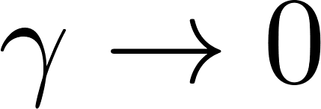
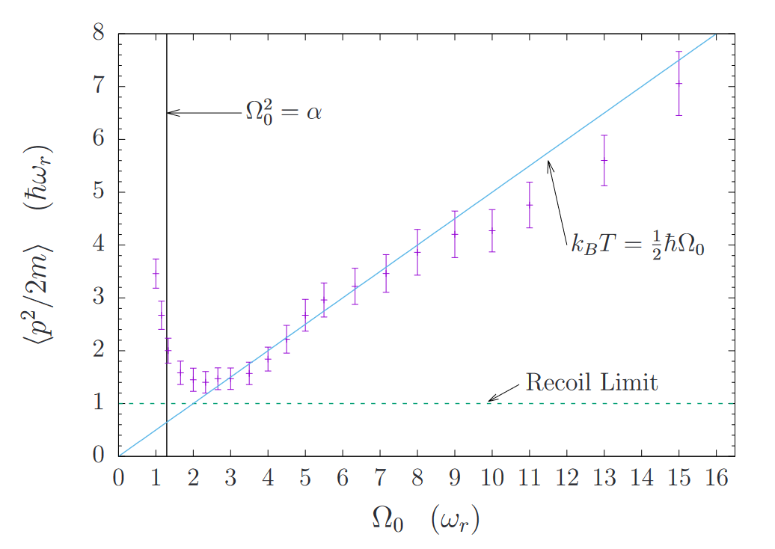
Temperature limit as
Reduced conservative force
+ high excited state fraction → more diffusion due to spon. emission
Decreased time ordering between
Adiabatic transfers → particles spend more time in the excited state

Slide 9
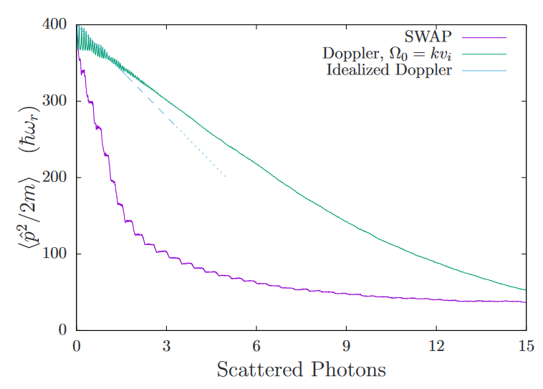
Cooling efficiency
Cooling efficiency ≡ energy removed per scattering
Many fewer scatterings required than Doppler
SWAP is well-suited to cooling e.g. particles that
lack closed cycling transitions

Slide 10
Applications

Slide 11
Extra material

Slide 12
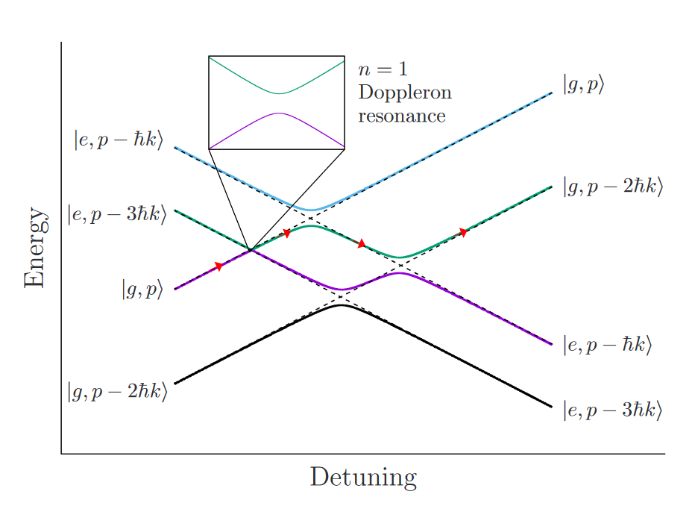
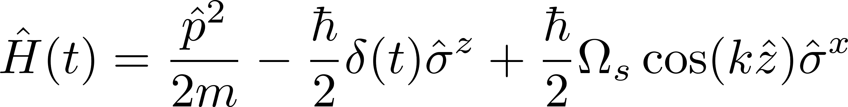
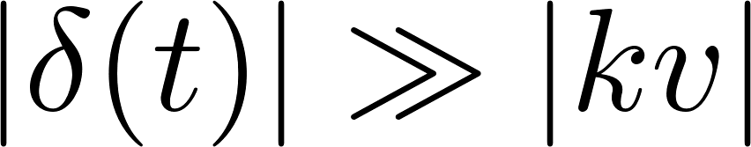
Dynamics
Large detuning limit:

Slide 13
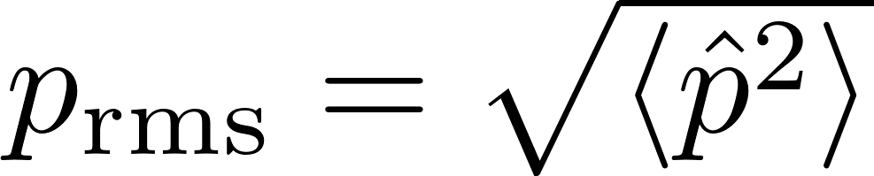
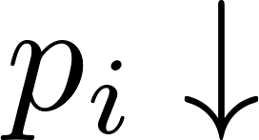
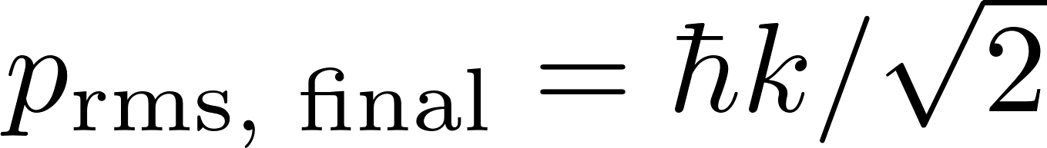
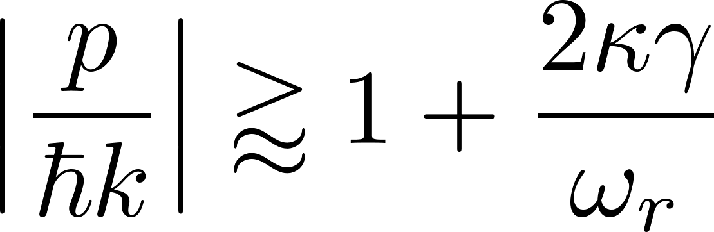
Dynamics
Coherent evolution:
→ Doppler shift decreases → pulse narrows
Effective force drives particle to zero velocity
→ unlike “slowing force” in e.g. chirped-frequency light
With spontaneous emission:

